Slide 1
Section 3.4: Bar Codes
Math for Liberal Studies

Slide 2
More Than Just Numbers
Many of the ID numbers we have studied need to be represented in a way that is readable by machines
While computers can recognize standard numbers, it is much faster and cheaper to use a simpler representation

Slide 3
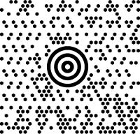
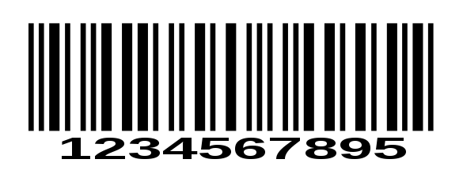
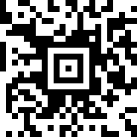
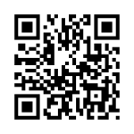
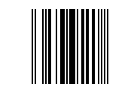
Many Kinds of “Bar” Codes

Slide 4
An Example: ERMA
The numbers on the bottom of a check are printed in magnetic ink
Since many numbers look similar to a computer, these numbers are drawn in a way that makes them appear sufficiently different from each other

Slide 5
POSTNET
The POSTNET code can be found on most mass-mail address labels, including junk mail and magazines
POSTNET stands for POSTal Numeric Encoding Technique
The code looks like this
The sequence of light and dark bars represents the ZIP+4 of the address

Slide 6
Reading the Code
Some bars are “tall” and some are “short”
The first and last bars are always tall; these are called guard bars and simply indicate where the code begins and ends
The remaining bars represent the digits of the ZIP code, plus a check digit

Slide 7
10 Digits, 10 Codes
The codes are read like this:
0 - llııı | 5 - ılılı
1 - ıııll | 6 - ıllıı
2 - ıılıl | 7 - lıııl
3 - ııllı | 8 - lıılı
4 - ılııl | 9 - lılıı

Slide 8
Translating the Code
Let’s translate this POSTNET code

Slide 9
Translating the Code
Let’s translate this POSTNET code
Using the chart (and remembering to ignore the guard bars), we can see that the code represents the digits 9567892725
The ZIP+4 represented here is 95678-9272, and the check digit is 5

Slide 10
POSTNET Check Digits
The check digit is chosen so that the sum of all the digits (including the check digit) ends in a zero
For example, the previous code was 95678-9272-5
We check: 9+5+6+7+8+9+2+7+2+5 = 60 ✓

Slide 11
The Number of Digits Varies
Sometimes the “plus 4” part of the ZIP code is missing, and so there will only be 6 total digits (5 digit ZIP code plus check digit)
Often there is an additional 2 digit code (called the “delivery point”) when the ZIP+4 isn’t enough information to identify the address

Slide 12
Another Example
This address label includes a POSTNET code
0 - llııı | 5 - ılılı
1 - ıııll | 6 - ıllıı
2 - ıılıl | 7 - lıııl
3 - ııllı | 8 - lıılı
4 - ılııl | 9 - lıılı

Slide 13
Another Example
This address label includes a POSTNET code
Using the table, we can decode the code: 171069050506
The ZIP+4 is 17106-9050 with delivery point 50
0 - llııı | 5 - ılılı
1 - ıııll | 6 - ıllıı
2 - ıılıl | 7 - lıııl
3 - ııllı | 8 - lıılı
4 - ılııl | 9 - lıılı

Slide 14
POSTNET Errors
You may have noticed that in the POSTNET code, all of the bar patterns have exactly two tall bars and three short bars
This allows the system to not only detect, but also correct errors
0 - llııı | 5 - ılılı
1 - ıııll | 6 - ıllıı
2 - ıılıl | 7 - lıııl
3 - ııllı | 8 - lıılı
4 - ılııl | 9 - lıılı

Slide 15
An Example
Consider the POSTNET bar code shown here
Show that this code has an error
Use the check digit to correct the error
lııılllııılıılılılılılıııllılıılllııllıııııllııllııllıııılııll
First break the code up into groups of 5

Slide 16
An Example
Consider the POSTNET bar code shown here
Show that this code has an error
Use the check digit to correct the error
l ıııll lıııl ıılıl ılılı lıııl lılıı lllıı llııı ııllı ıllıı llııı ılııl l
First break the code up into groups of 5

Slide 17
An Example
Consider the POSTNET bar code shown here
Show that this code has an error
Use the check digit to correct the error
l ıııll lıııl ıılıl ılılı lıııl lılıı lllıı llııı ııllı ıllıı llııı ılııl l
We can tell that the code is 172579?03604
How can we determine the missing digit?

Slide 18
An Example
We can tell that the code is 172579?03604
l ıııll lıııl ıılıl ılılı lıııl lılıı lllıı llııı ııllı ıllıı llııı ılııl l
We know immediately that this digit is wrong because it has 3 tall bars and 2 short bars
The correct digit could be 0 (llııı), 6 (ıllıı), or 9 (lılıı)

Slide 19
An Example
We can tell that the code is 172579?03604
l ıııll lıııl ıılıl ılılı lıııl lılıı lllıı llııı ııllı ıllıı llııı ılııl l
All of the digits, including the check digit, should add up to a number ending in 0
1+7+2+5+7+9+?+0+3+6+0+4 = 44 + ?
So the missing digit is 6

Slide 20
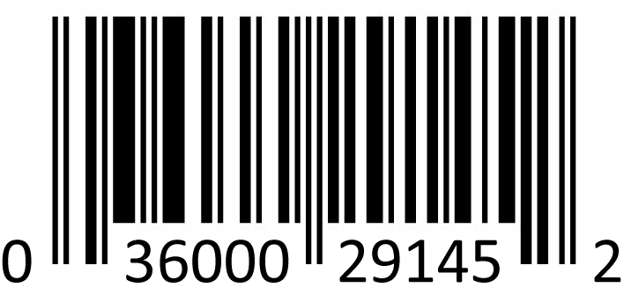
UPC Bar Codes
We have already discussed the 12 digit UPC
How is the pattern of light and dark vertical bars related to this code?
The bars represent those digits in a way that can be read by scanners (such as those in the supermarket)

Slide 21
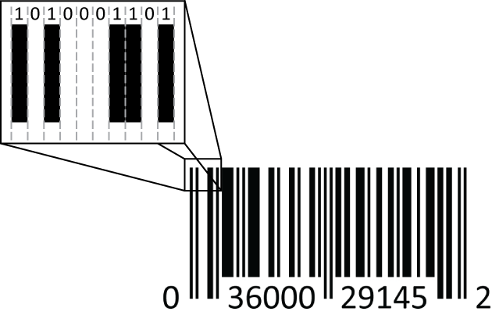
Looking at a Bar Code
The light and dark bars represent patterns of 0’s and 1’s
Light = 0, Dark = 1

Slide 22
The Parts of the UPC Bar Code
Similar to the guard bars at the beginning and end of the POSTNET bar code, the UPC bar code has certain features that help the scanner determine how to read the code
One problem that scanners encounter is that bar codes on different products have different sizes

Slide 23
Breaking It Down
The bar code breaks down like this:
101 – the code starts with this alternating pattern to help the scanner determine how wide each bar is
First 6 digits – each digit is represented by 7 bars
01010 – this code separates the left-hand side of the code from the right-hand side
Last 6 digits – each digit is again represented by 7 bars
101 – the code ends like it begins, with another “guard” pattern

Slide 24
Binary Coding
The code for translating digits 0-9 into light and dark bars is “binary”
Binary means we only have two options: 0 or 1, light or dark
The POSTNET code is also binary: tall or short

Slide 25
Rules for Encoding UPC Bar Codes
Use this table to determine how to translate from digits 0-9 to sequences of 0’s and 1’s
Notice that the rules are different for “left side” digits versus “right side” digits
Digit | Left-side | Right-side
0 | 0001101 | 1110010
1 | 0011001 | 1100110
2 | 0010011 | 1101100
3 | 0111101 | 1000010
4 | 0100011 | 1011100
5 | 0110001 | 1001110
6 | 0101111 | 1010000
7 | 0111011 | 1000100
8 | 0110111 | 1001000
9 | 0001011 | 1110100

Slide 26
Why Different Rules?
Why would we use different rules for the left side and the right side?
Notice that all the left-side digits have an odd number of 1’s and the right-side digits have an even number of 1’s
This allows the scanner to read the code even if the code is upside down!

Slide 27
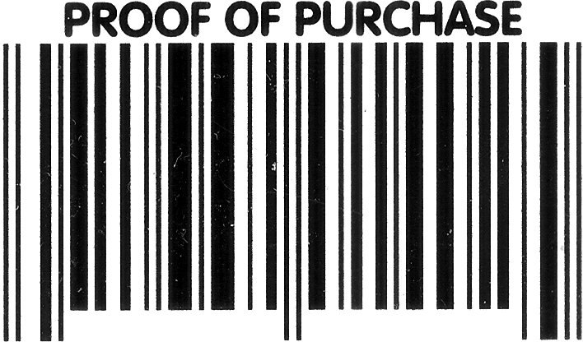
Reading a Code
Use the table from the previous slide to decode this UPC bar code
Answer: 0-71662-01402-5

